Slide 1
Small Adaptable Mother Ship Design Space Exploration
PF Naughton
29 February 2020

Slide 2
Project Summary
This presentation summarizes an early stage design space exploration for small, ocean-going, vessels optimized to serve as mother ships for automated and/or autonomous (A&A) small craft, including;
Investigation of Potential Roles for a Small Adaptable Mother Ship (SAMS)
Parametric Analyses of Dimensions and Weights
Investigation of Design Constraints
Analyses of Unique Design Features, particularly in way of Powering and Organic Overboard Vehicle (OOV) handling features
Investigation of any special design evaluation tools
Analyses of design space key to successful SBD process

Slide 3
Target Market
MCMVs and AGORs frequently employ remotely piloted vehicles (and more recently A&A small craft)
Many NATO and friendly navies in need of replacing legacy Mine Counter Measures Vessels (MCMVs)
Also ongoing need for oceanographic vessels (AGORS), Offshore Patrol Vessels (OPVs) and other ancillary naval vessels
Dedicated, single-role vessels can be expensive due to
short production runs
stringent design requirements (such as low signatures)
need to accommodate mission specific equipment
SAMS outfitted with modular A&A systems can provide navies with a relatively low cost, multi-use platform, to take the place of multiple one-off or limited run specialized vessels

Slide 4
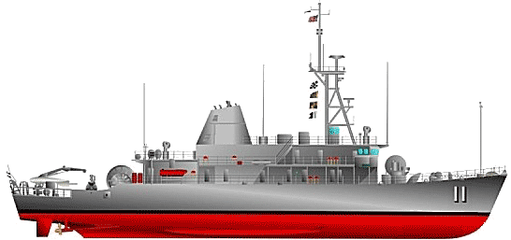
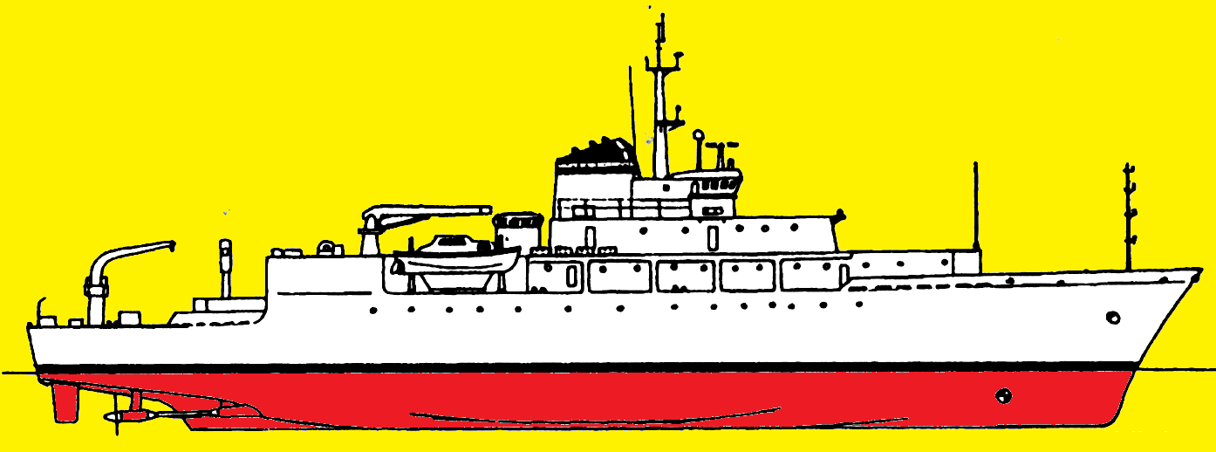
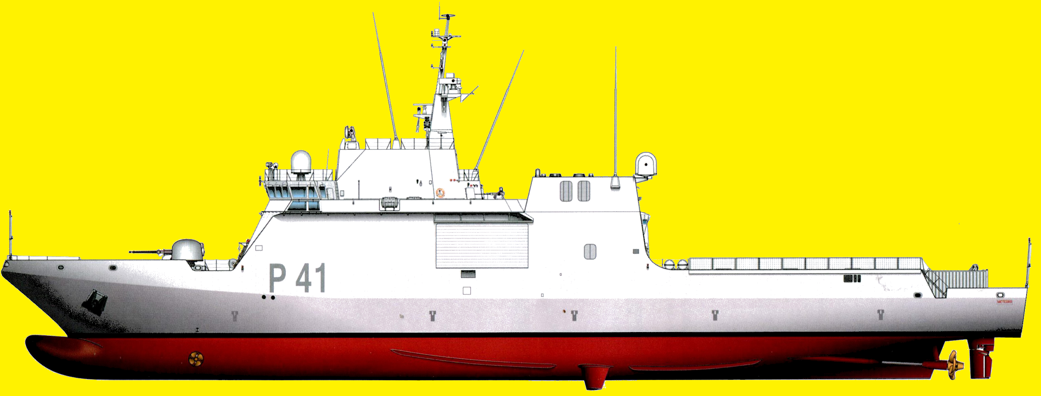
Innovations
Legacy MCMVs typically specially designed low-signature/shock resistant/high-cost vessels, with limited range and endurance
Use of A&A craft can now allow MCMVs to;
stand off from immediate threat area,
deploy unmanned craft to detect and neutralize mine threats,
Allows for a simpler, less costly mothership to perform the same role
Also potential to increase propulsion power and vessel range for Mother Ship due to use of simpler (less noise controlled and shock resilient) propulsion plant
One Mother Ship can be re-outfitted to perform different roles throughout its service life (including research, law enforcement, and low intensity naval roles) reducing need to maintain multiple specialized vessel types

Slide 5
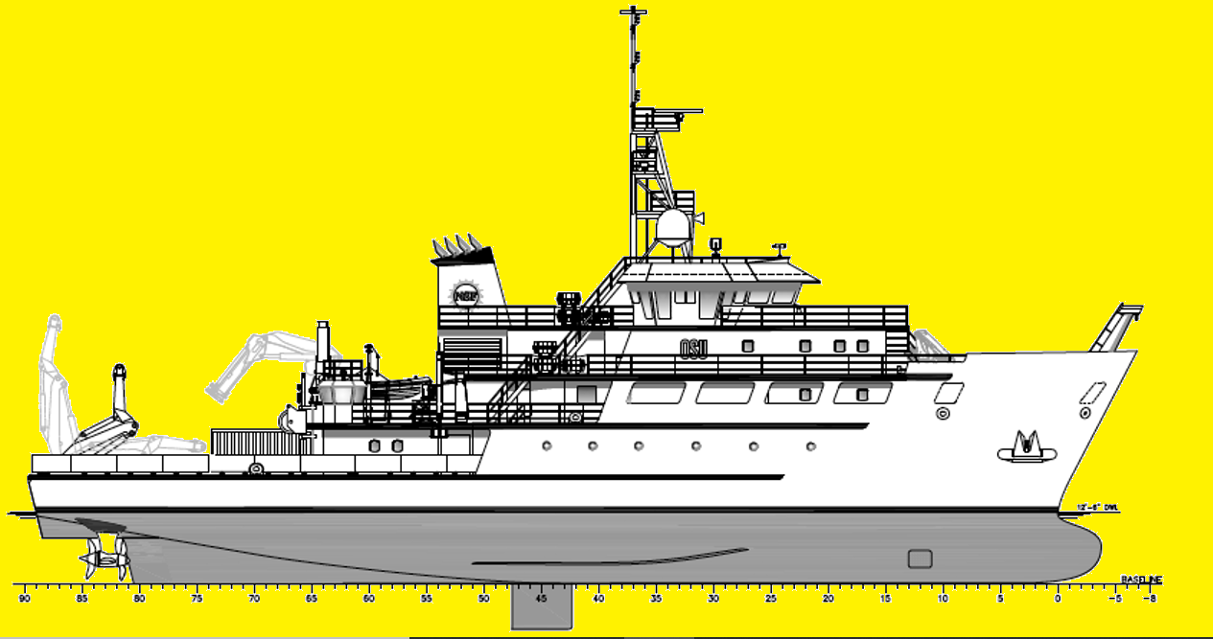
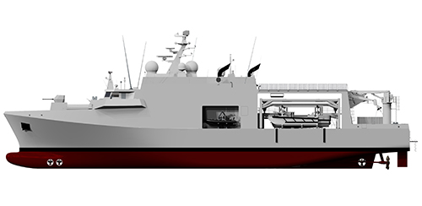
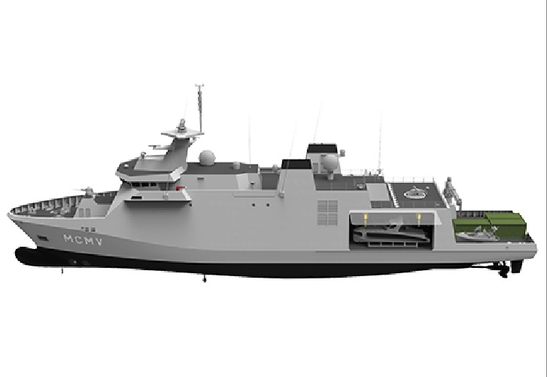
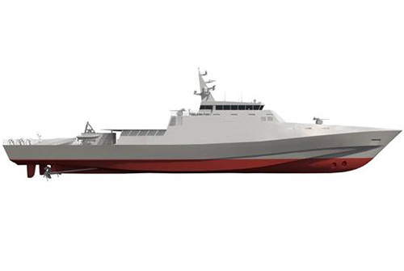
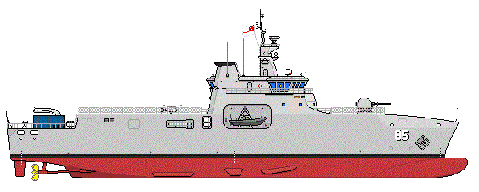
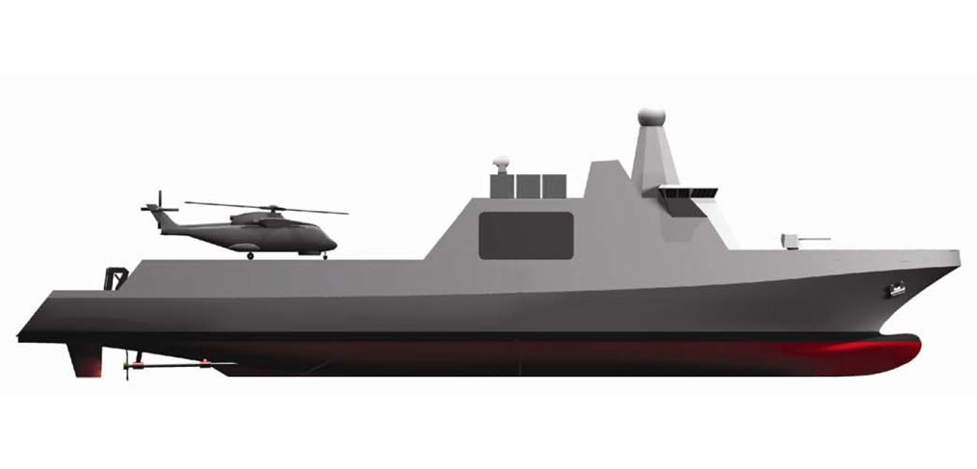
Competition
US currently committed to LCS for future MCM mission
However still ongoing need for future research vessels
Belgian and Dutch Navies recently signed a contract for twelve 81m MCMVs designed to employ A&A type overboard craft
DAMEN had also submitted a 91m “Mother Ship” for this contract
SAAB is currently marketing an 80m MCMV platform & BMT is marketing an 85m platform
both designed to support the use of A&A craft in the MCM mission
RN has previously investigated a single platform for future Hydrographic Research and Mine Counter Measures needs
Existing Design Tools such as ASSET and RSDE mostly aimed at larger (FF, DD, and CG) sized surface combatants

Slide 6
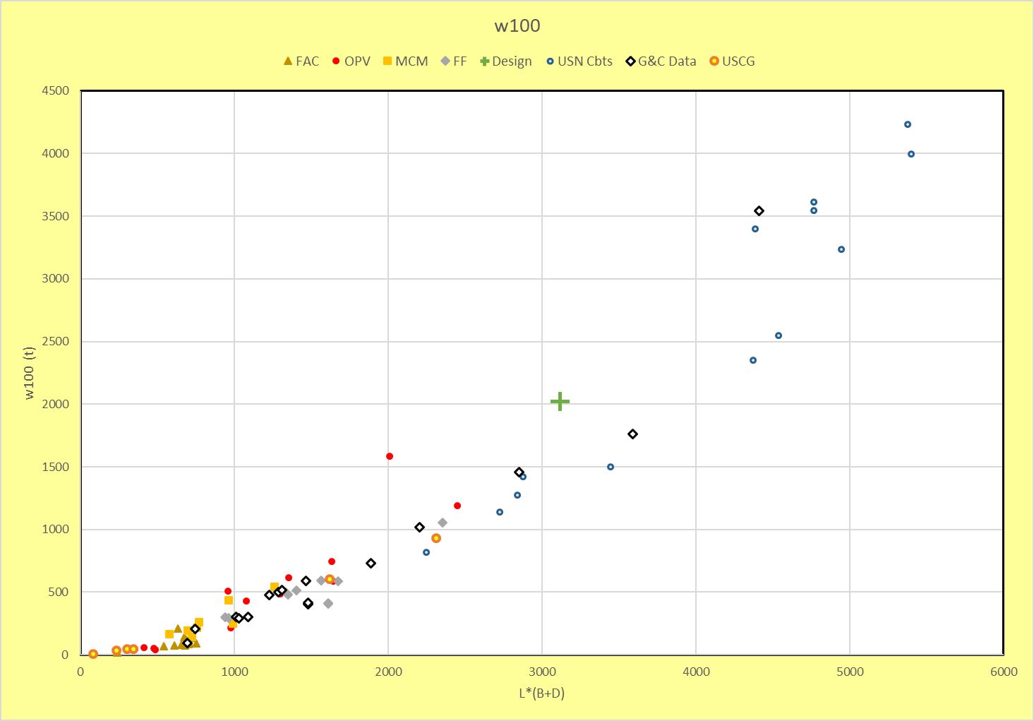
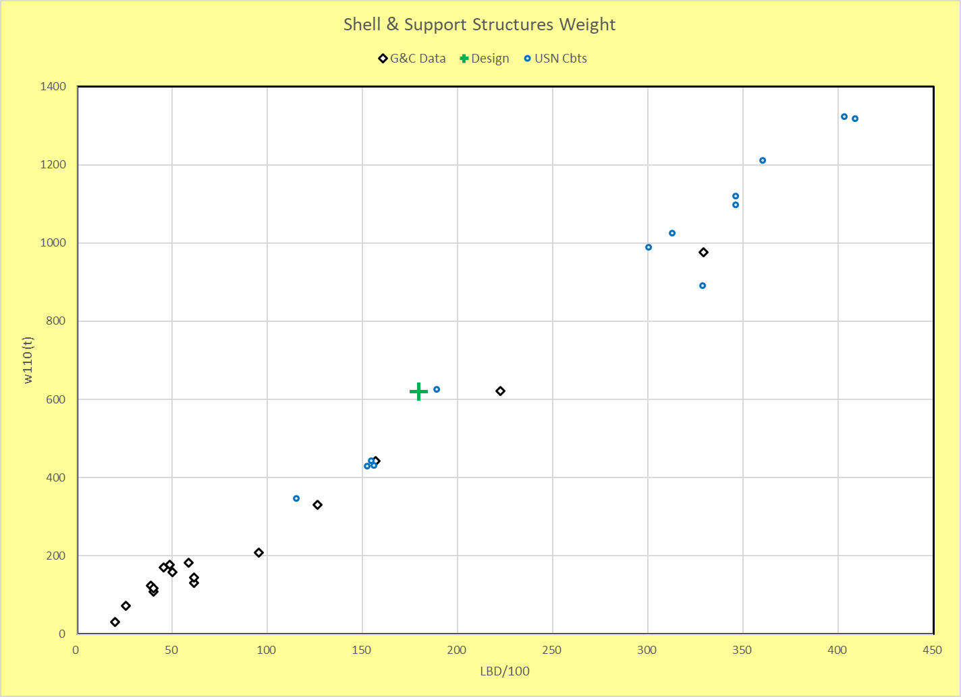
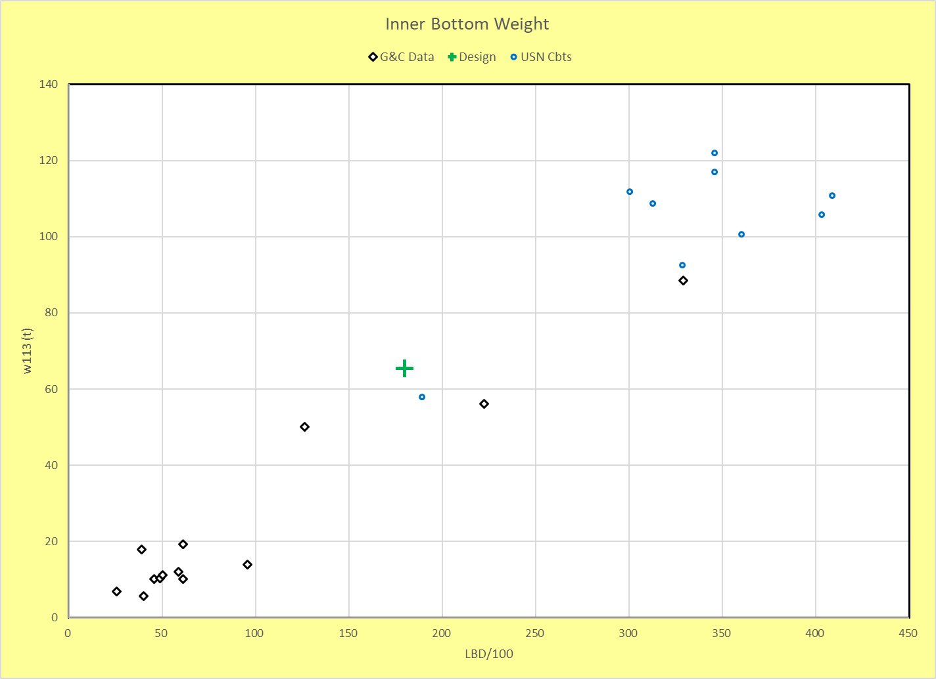
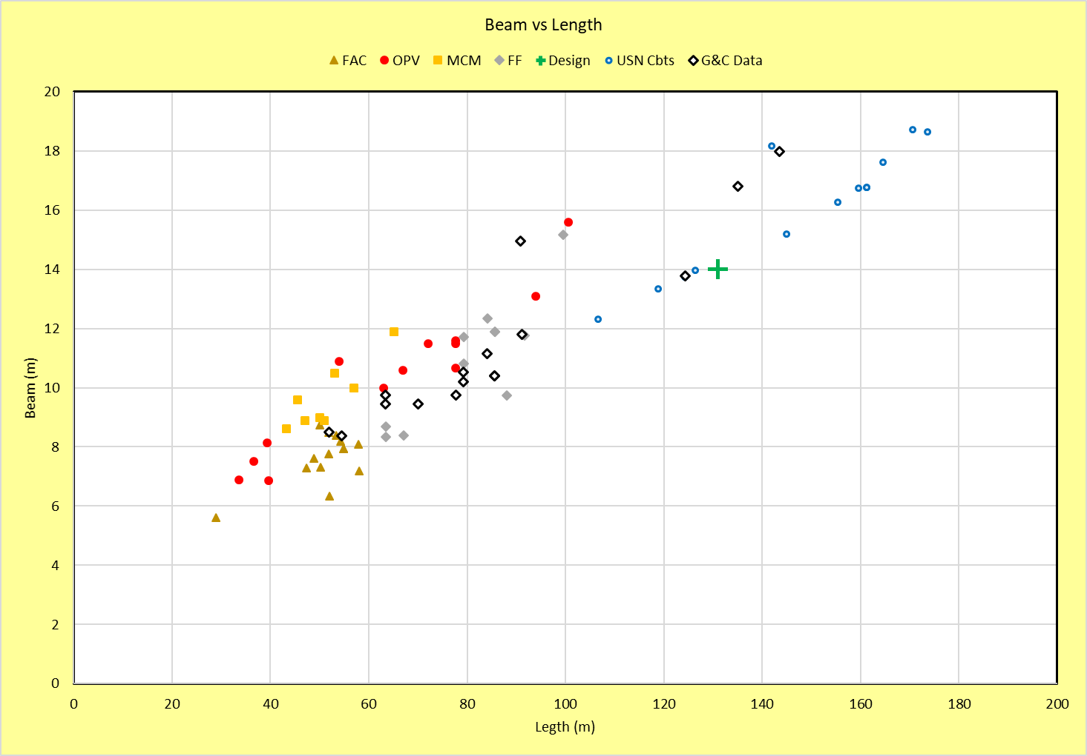
Parametric Analyses of Dimensions & Weights
Collected weight and dimensional data for a wide range of legacy modern naval vessels and design studies into a single EXCEL Spreadsheet
Reviewed data for design trends
Sample Database Plots
Database consists weights and dimensional data for,
3-Digit SWBS 100-700 (13 vessels)
3-Digit SWBS 100 only (16 vessels)
1-Digit SWBS 100-700 (additional 37 vessels)
Dimensional data on 271 additional small combatants

Slide 7
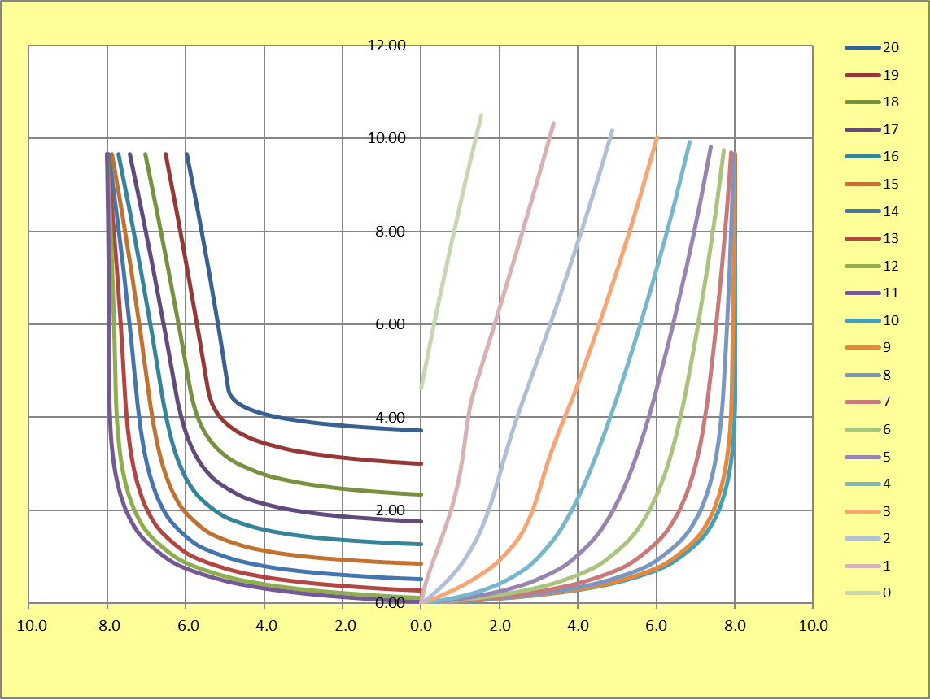
Potential Length Constraints
Design Length
> 91m (300ft) - damage length of 15%L for combatants
12.5%L for auxiliaries (often includes OPVs)
< 91m (300ft) - 2-compartment flooding
Maximum fire zone length - 40m (131ft)
Vessels < 75-80m (245-260ft) often require only two main fire zones (reducing the need for additional fire pumps, piping, fitting & insulation)
Sample Arrangements & Hullform Tool
Required stack up length can be a limiting factor for designs

Slide 8
Current Status & Recommendations
A design space exploration for small, ocean-going, vessels optimized to serve as mother ships for automated and/or autonomous (A&A) small craft was initiated
A database of small vessels was compiled
Weight and dimensional trends have been reviewed
Potential design constraints have also been identified
Simple tools to help evaluate specific constraints have been looked into
This analyses can assist in early stage concept design and estimating for small vessels suitable for use as a SAMS
Further work on:
Expanding the database
Exploring length constraints (including floodable lengths), machinery options (including space and weight imapcts), and OOV handing concepts can be beneficial to assist in assessing feasibility of future mothership concept designs

Slide 9
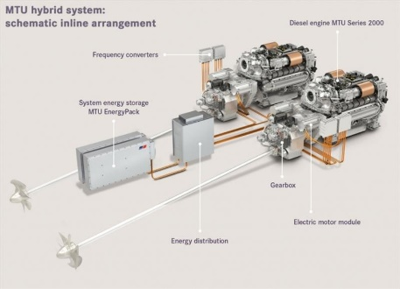
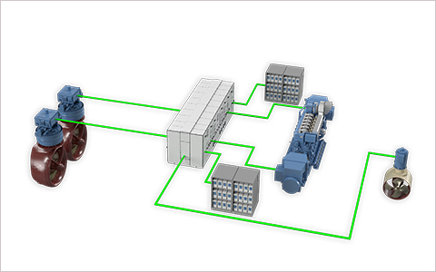
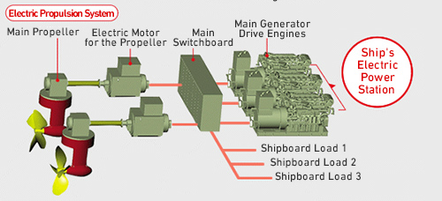
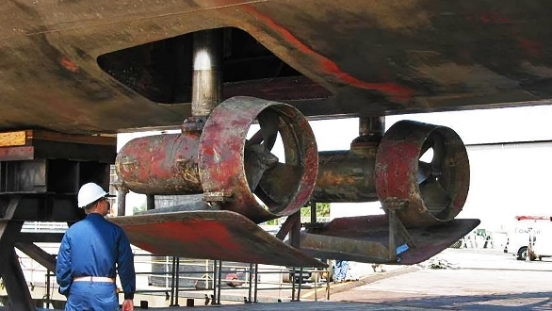
Power Plant Considerations
Power Plant Configuration
Because SAMS may end up spending large amount of time at low speeds (<6-8kts) deploying/retrieving and/or operating craft, need either;
main propulsion plant that can operate reliably and efficiently at low speeds, or
auxiliary propulsor specifically for lower speeds operations
Loiter operations likely to play a major role in selection of propulsion machinery

Slide 10
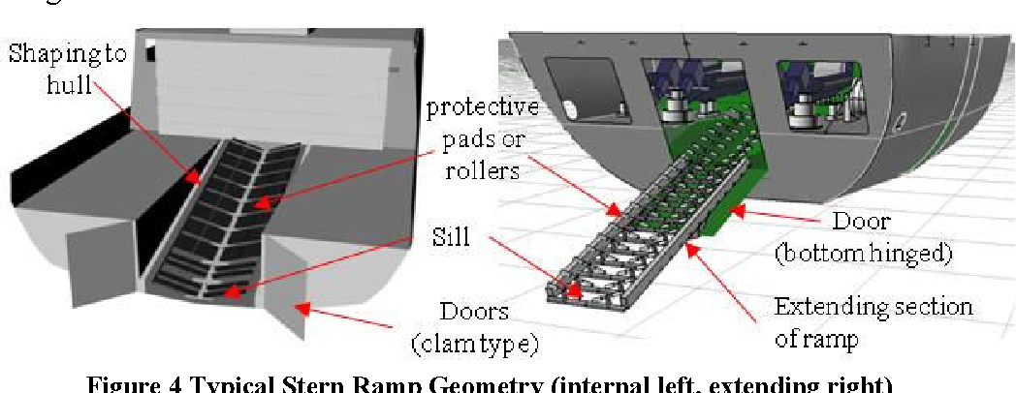
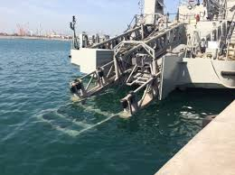
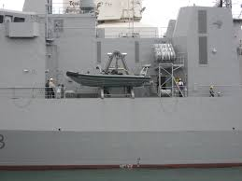
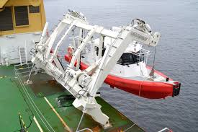
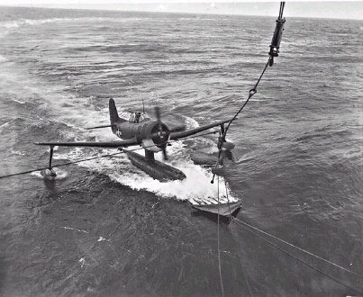
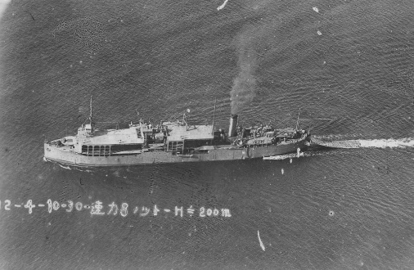
OOV Handling Features
Modern OOV Handling Methods
Relative Motions & Velocities between Mothership and OOVs play a big role in ability to launch/recover OOVs
Historical Concepts to attenuate relative motions
Means of reducing differences in relative motions can improve launch/recovery capabilities

Slide 11
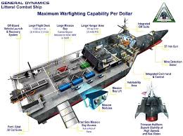
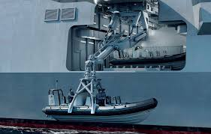
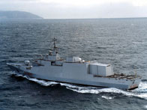
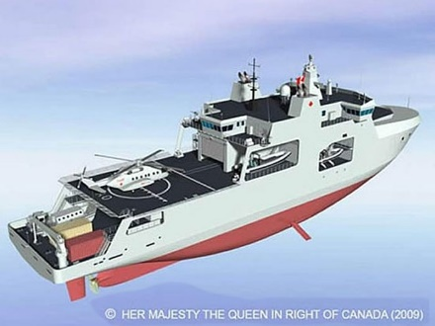
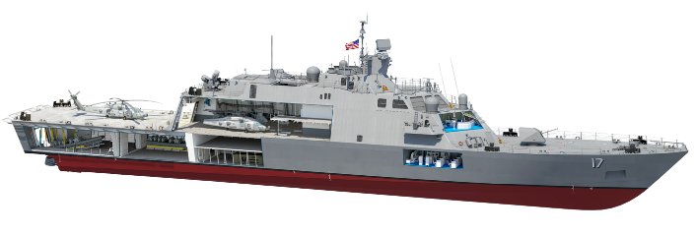
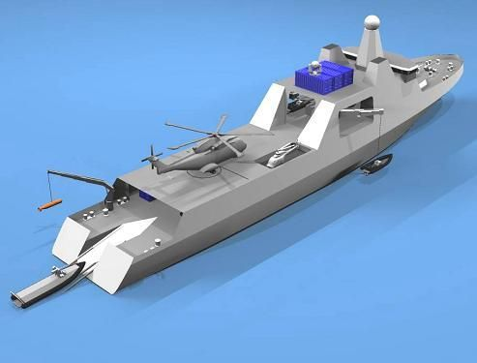
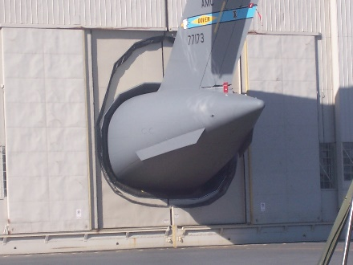
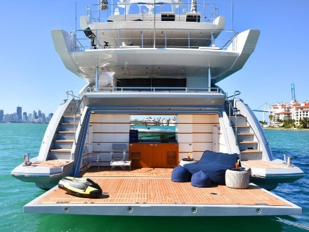
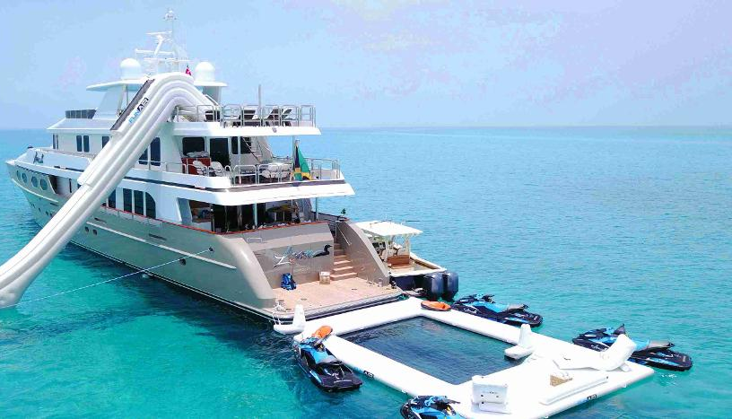
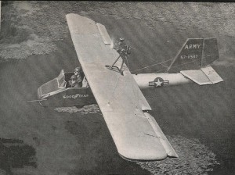
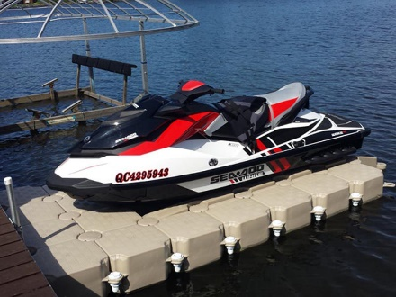
OOV Stowage Features
Modern Hangar/Mission Zone Concepts
Potential Future Concepts
Potential exists to increase flexibility of onboard stowage spaces

