Slide 1
SHP0092 & SHP0092A
Drake Platenberg – LSC Affordability + Ship Concepts and Benchmarking Leads
Patrick Naughton – LSC SHP Concept Development
12-14-2020

Slide 2
Background
SHP0092/0092A
Based on the evaluation of Capability Extension Program (CEP) SHP 0078 additional analyses have been proposed to investigate revised IPS machinery, using AIM motor technology, for a lower speed requirement of 28 kts Base Model and 29 kts with CEP (SHP 0092/0092A).
This will allow comparison to SHP 0078 for the cost impact of increased Sustained Speed with Base Model/CEP approach, similar to comparison performed for PMM motor SHP Concepts SHP 0068 and SHP 0071.

Slide 3
SHP0092A - Description
CEP Block Future
A lengthened CEP design with additional warfighting capability (WSS 30) outfitted in the mid-body hull section forward of MMR1.
Outfitted with two 30 MW AIMS, two LM 2500 G4+ GTGs plus two diesel main propulsion generators to allow the vessel to attain a 29kt sustained speed and meet ASM-SHP-005 while equipped with WSS 030.
Main Propulsion generators are configured in two MMRs, one forward of the motor room and one aft, each arranged with 1 GTG and 1 main propulsion diesel generator.
Motors collocated (VUL #1 machinery survivability); 2 MW single APU in bow..

Slide 4
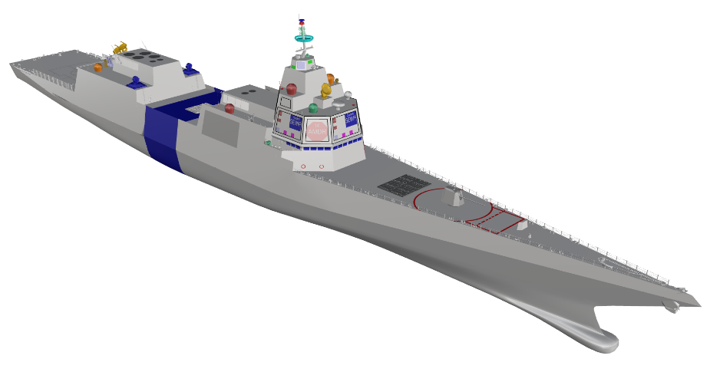
SHP0092A
IPS CEP Block Future
DIMENSIONS:
Length, Overall: 197.0m
LBP: 182.0 m
DWL Beam: 21.9 m
Design Draft: 7.2 m
Hull Depth: 15.5 m
MOBILITY & ENDURANCE
Speed, Sustained(80%): 28.0 kts
Speed, Maximum (100%): 29.6 kts
Endurance @ 16kts: 6,000 nm
Annual Fuel Burn: XX.X k Brls
Time on Station: XX.X Days
ACCOMMODATIONS:
Officers CPO Enlisted Total
Manning 39 32 287 358
Accom 42 35 313 390
POWER & PROPULSION:
13.8 kVAC Integrated Power System (IPS)
Power, Installed 69.2 MW
Electric Load, 24hr Ave 6.1 MW
(2) 27.6 MW LM 2500 G4+ GTG
(2) 7.0 MW 20V PA6B DG
(2) 30 MW Advanced Induction Motor
(2) 5.62 m diameter Fixed Pitch Propellers
(1) 2.0 MW Retractable Azimuthing Auxiliary Propulsion Units
AUXILIARY SYSTEMS:
(5) 500 rton A/C Plants
WEIGHTS:
SWBS 100 5,811 t
SWBS 200 2,011 t
SWBS 300 581 t
SWBS 400 551 t
SWBS 500 1,442 t
SWBS 600 800 t
SWBS 700 566 t
Lightship 11,763 t
Design Margins 1,176 t
Lightship w/ Margin 12,939 t
Loads 2,001 t
Full Load (8.63m KG) 14,940 t
EOSL (8.93m KG) 16,435 t
WARFARE SYSTEMS:
Warfare System Set 0030 Installed
Embarked Warfare CDR (24 staff)
WEAPON SYSTEMS:
(96) MK 41 Mod 15 VLS
(12) MK XX Large VLS
(1) MK 45 Mod 4 5”/62 Gun
(3) MK 38 MOD 4 30mm MGS
(2) 600kW Lasers
(3) MK 99 Mod 14 FCS
(2) MK 32 SVTT
MK 43 Mod 0 TTWCS V5.4.0.2
MK 34 Mod 8 GWS w/MK 20 EOSS
SURVEILLANCE:
AN/SPY-6(V)1 AMDR (14ft)
Future X Band Radar (FXR)
NTCDL Ku Phased Array
SPECTRAL/COLBRA (Replace SSEE)
EO/IR System (SPEIR/Stalker)
UPX-29 IFF System
AN/SQR-20 MFTA plus Spare
SQS-53C Bow Mounted Sonar
SLA (SWAP-C + Backfit Reservations Space Only)
Area, Unassigned 3.2%
Weight 10%
KG 0.30 m
Cooling 20%
Service Life 35 years
NAVIGATION:
DDG 51 Flt III Like Nav Systems
AN/SPS-73 (V) 18 Next Generation
Surface Search Radar (NGSSR)
COMMAND & CONTROL:
Future Integrated Combat System (FICS)
(6) CWC Consoles
(4) USV Control Consoles
EW & DECOY:
AN/SLQ-32(V)7 SEWIP BLK III
MK 53 Mod 5 DLS - SRBOC, NULKA
AN/SLQ-25E NIXIE
ADC MK2 Mod 4/6 Torpedo CM
C4I SYSTEMS:
DDG 51 Flt III Like Comms. Systems
FORCE PROTECTION:
50 Cal Machine Guns
MK 19 Grenade Launcher
FLEXIBILITY:
FPA0005 (Flexible Planar Array)
Flexible Infrastructure in Mission Spaces
15% Wider Passageways
AVIATION FACILITIES
Aircraft/hangar: 2x MH-60R
Or 1x MH-60R + 2x UAV/MALE
Landing Spots: 1x with ASIST
BOATS
Side Launch BHS-0055
2x 7m RHIB
AFFORDABILITY:
10th Ship TY$19 $X.XXB
1st Ship TY$19 $X.XXB
Key: Critical Systems

Slide 5
SHP0092A – Stackup Arrangements

Slide 6
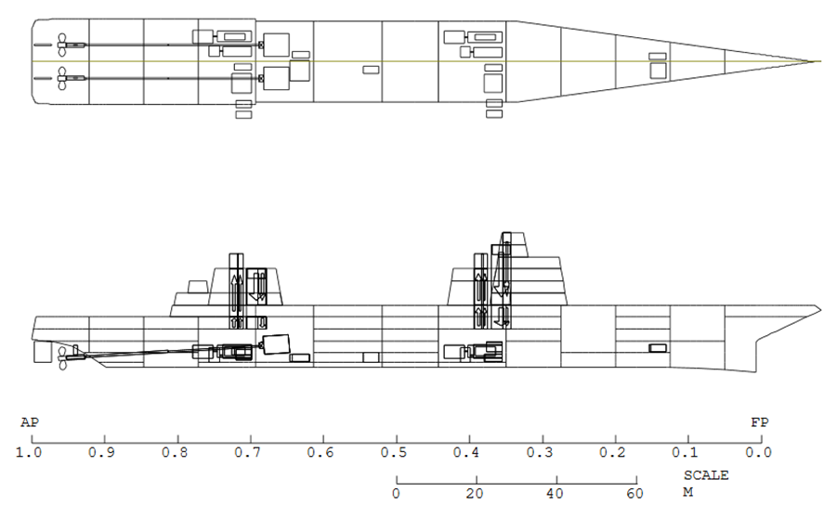
SHP0092A - ASSET in-board profile

Slide 7
SHP0092A Principle Characteristics Pt1
ID | SHP0044 | SHP0068A | SHP0078A | SHP0092A | units
Lwl/LBP | 176.0 | 176.6 | 182.3 | 182.0 | m
Beam | 22.5 | 21.8 | 21.7 | 21.9 | m
Depth | 15.5 | 15.5 | 15.5 | 15.5 | m
Design Draft | 7.1 | 7.21 | 7.21 | 7.21 | m
Full Load Draft | 6.79 | 7.03 | 7.20 | 7.07 | m
Full Load Disp | 13,944 | 14,318 | 15,258 | 14,941 | mt
Accommodations | 390 | 390 | 390 | 390
Ballast Tankage Sizing Criteria | 0.33 | 0.50 | 0.50 | 0.50
GM/B BOSL Full Ld |  | 12.4 | 13.0 | 13.2 | %
GM/B EOSL Min Op |  | 10.3 | 11.0 | 10.7 | %

Slide 8
SHP0092A Principle Characteristics Pt2
ID | SHP0044 | SHP0068A | SHP0078A | SHP0092A | units
Installed Power | 71.4 | 71.4 | 86.0 | 69.2 | MW
Max Speed | 30.3 | 30.0 | 31.0 | 29.6 | kt
Sustained Seed | 29.1 | 28.7 | 29.6 | 28.0 | kt
Endurance Range | 6,000 | 6,000 | 6,000 | 6,000 | NM
Fuel Load | 1,131 | 1,234 | 1,322 | 1,299 | mt
WSS Installed | 0025 | 0030 | 0030 | 0030
Machinery Select # | 11A | 11D | 18 | 26

Slide 9
SHP0092 - Description
Base Model
SHP Concept designed for future CEP, delivered without extended hull section
Outfitted with the same AIMs, Power Generating plant, and main machinery layout as SHP 0092A
Sustained speed is calculated as a product of the reduction in hull length required for the CEP
Outfitted with WSS 0029.

Slide 10
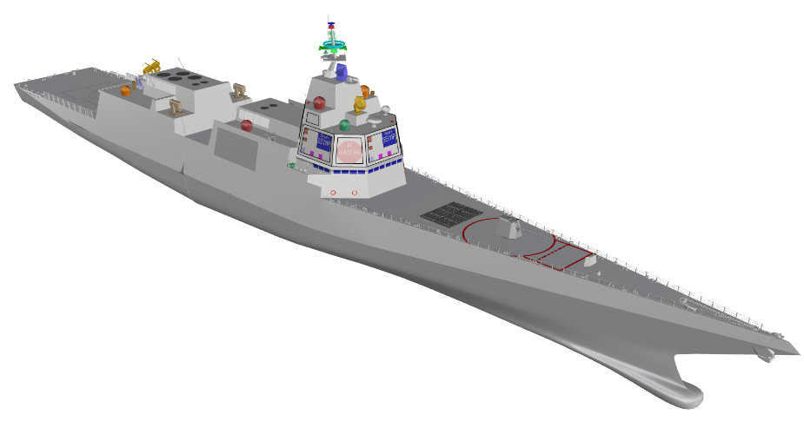
SHP0092
IPS Base Model (CEP Hull Extension Removed)
DIMENSIONS:
Length, Overall: 178.6 m
LBP: 165.0 m
DWL Beam: 21.9 m
Design Draft: 7.2 m
Hull Depth: 15.5 m
MOBILITY & ENDURANCE
Speed, Sustained(80%): 27.9 kts
Speed, Maximum (100%): 29.1 kts
Endurance @ 16kts: 6,000 nm
Annual Fuel Burn: XX.X k Brls
Time on Station: XX.X Days
ACCOMMODATIONS:
Officers CPO Enlisted Total
Manning 32 26 276 334
Accom 35 29 302 366
POWER & PROPULSION:
13.8 kVAC Integrated Power System (IPS)
Power, Installed 69.2 MW
Electric Load, 24hr Ave 5.5 MW
(2) 30.0 MW LM 2500 G4+ GTG
(2) 7.0 MW 20V PA6B DG
(2) 30 MW Advanced Induction Motor
(2) 5.62 m diameter Fixed Pitch Propellers
(1) 2.0 MW Retractable Azimuthing Auxiliary Propulsion Units
AUXILIARY SYSTEMS:
(4) 500 rton A/C Plants
WEIGHTS:
SWBS 100 5,256 t
SWBS 200 1,962 t
SWBS 300 512 t
SWBS 400 524 t
SWBS 500 1,305 t
SWBS 600 744 t
SWBS 700 288 t
Lightship 10,591 t
Design Margins 1,059 t
Lightship w/ Margin 11,650 t
Loads 1,770 t
Full Load (8.30m KG) 13,421 t
EOSL (8.60m KG) 14,767 t
WARFARE SYSTEMS:
Warfare System Set 0029 Installed
WEAPON SYSTEMS:
(96) MK 41 Mod 15 VLS
(1) MK 45 Mod 4 5”/62 Gun
(3) MK 38 MOD 4 30mm MGS
(3) MK 99 Mod 14 FCS
(2) MK 49 RAM GMLS
MK 43 Mod 0 TTWCS V5.4.0.2
MK 34 Mod 8 GWS w/MK 20 EOSS
SURVEILLANCE:
AN/SPY-6(V)1 AMDR (14ft)
AN/SPQ-9B
NTCDL Ku Phased Array
SPECTRAL/COLBRA (Replace SSEE)
EO/IR System (SPEIR/Stalker)
UPX-29 IFF System
AN/SQR-20 MFTA plus Spare
SQS-53C Bow Mounted Sonar
SLA (SWAP-C + Backfit Reservations Space Only)
Area, Unassigned 1.2%
Weight 10%
KG 0.30m
Cooling 20%
Service Life 35 years
NAVIGATION:
DDG 51 Flt III Like Nav Systems
AN/SPS-73 (V) 18 Next Generation
Surface Search Radar (NGSSR)
COMMAND & CONTROL:
B/L 10 CMS
(2) USV Control Consoles
EW & DECOY:
AN/SLQ-32(V)7 SEWIP BLK III
MK 53 Mod 5 DLS - SRBOC, NULKA
AN/SLQ-25E NIXIE
ADC MK2 Mod 4/6 Torpedo CM
C4I SYSTEMS:
DDG 51 Flt III Like Comms. Systems
FORCE PROTECTION:
50 Cal Machine Guns
MK 19 Grenade Launcher
FLEXIBILITY:
WSS 0030 Backfittable w/ CEP
  2x600kW Lasers
  (12) MK XX Large VLS
  Embarked Warfare CDR (24 staff)
FPA0005 (Flexible Planar Array)
Flexible Infrastructure in Mission Spaces
15% Wider Passageways
AVIATION FACILITIES
Aircraft/hangar: 2x MH-60R
Or 1x MH-60R + 2x UAV/MALE
Landing Spots: 1x with ASIST
BOATS
Side Launch BHS-0055
2x 7m RHIB
AFFORDABILITY:
10th Ship TY$19 $X.XXB
1st Ship TY$19 $X.XXB
Key: Critical Systems

Slide 11
SHP0092 – Stackup Arrangements

Slide 12
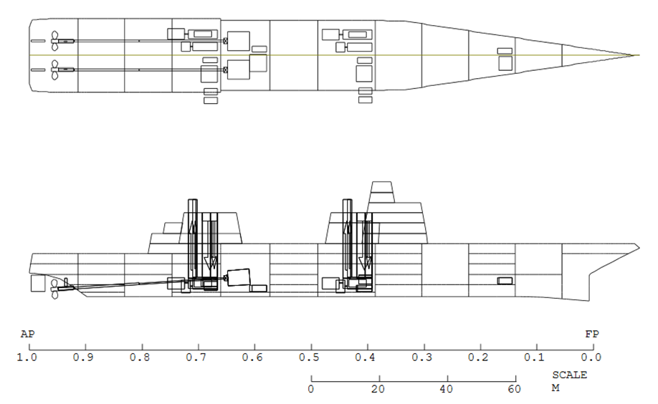
SHP0092 - ASSET in-board profile

Slide 13
SHP0092 Principle Characteristics Pt1
ID | SHP0044 | SHP0068 | SHP0078 | SHP0092 | units
Lwl/LBP | 176.0 | 159.3 | 165.0 | 165.0 | m
Beam | 22.5 | 21.8 | 21.7 | 21.9 | m
Depth | 15.5 | 15.5 | 15.5 | 15.5 | m
Design Draft | 7.1 | 7.21 | 7.21 | 7.21 | m
Full Load Draft | 6.79 | 7.01 | 7.18 | 7.01 | m
Full Load Disp | 13,944 | 12,856 | 13,735 | 13,421 | mt
Accommodations | 390 | 366 | 366 | 366
Ballast Tankage Sizing Criteria | 0.33 | 0.5 | 0.5 | 0.5
GM/B BOSL Full Ld |  | 13.7 | 13.9 | 14.7 | %
GM/B EOSL Min Op |  | 10.6 | 11.4 | 12.2 | %

Slide 14
SHP0092 Principle Characteristics Pt2
ID | SHP0044 | SHP0068 | SHP0078 | SHP0092 | units
Installed Power | 71.4 | 71.4 | 86.0 | 69.2 | MW
Max Speed | 30.3 | 29.3 | 30.3 | 29.1 | kt
Sustained Seed | 29.1 | 28.1 | 29.0 | 27.9 | kt
Endurance Range | 6,000 | 6,000 | 6,000 | 6,000 | NM
Fuel Load | 1,131 | 1,129 | 1,201 | 1,188 | mt
WSS Installed | 0025 | 0029 | 0029 | 0029
Machinery Select # | 11A | 11D | 18 | 26

Slide 15
CEP Round 3 Weight Comparison

Slide 16
Backup

